Slide 1


GIVE ‘EM
A BREAK
why? when? how? what?

Slide 2
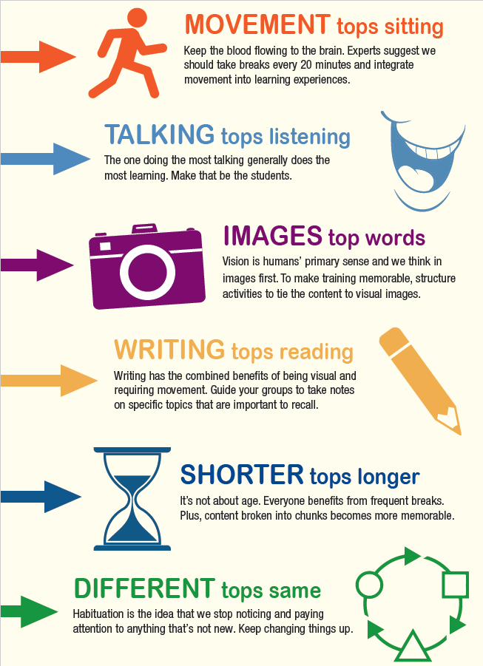
6 BRAIN RULES
Which suggest that BREAKS could be beneficial?
Credit: Sharon Bowman; Bowperson Training
Notes:
Our 6 BRAIN PRINCIPLES…
Often applied to HOW WE DELIVER CONTENT, but they also relate to breaks!
Which suggest that BREAKS could be good?

Slide 3


TRUE OR FALSE?
The HIPPOCAMPUS (short-term memory center)
has unlimited capacity.
Notes:
TRUE OR FALSE?

Slide 4

TRUE OR FALSE?
Middles are more memorable than “intros” and “endings.”
Notes:
TRUE OR FALSE?

Slide 5

Which answer is FALSE?
Breaks are most effective when they…
Are “off topic”
Get us moving around
Occur at regular intervals
Challenge our mind & creativity
Cross right & left sides of the body
Notes:
The breaks in Every 20 minutes attempt to keep these basic principles in mind.
Each brief break offers an assortment of full body motion, off-topic (not off color) jokes and exercises, music and amusement.

Slide 6
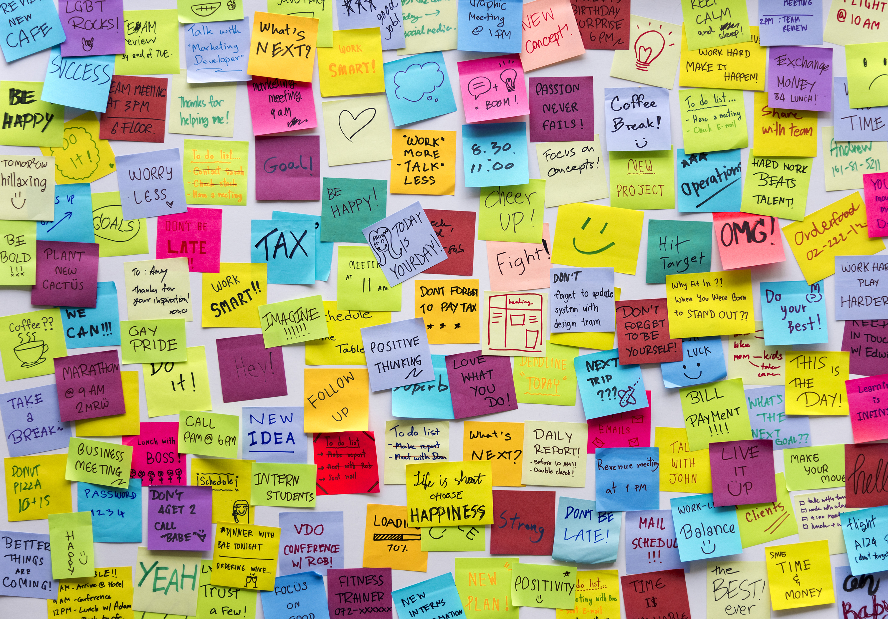
TRUE OR FALSE?
If we sit for more than 20 minutes, blood pools in our seat and feet.
Notes:
When we sit for more than 20 minutes, our blood pools in our seat and our feet. By getting up and moving, we recirculate that blood.
Within a minute, there is about 15% more blood in our brain. We do think better on our feet!

Slide 7
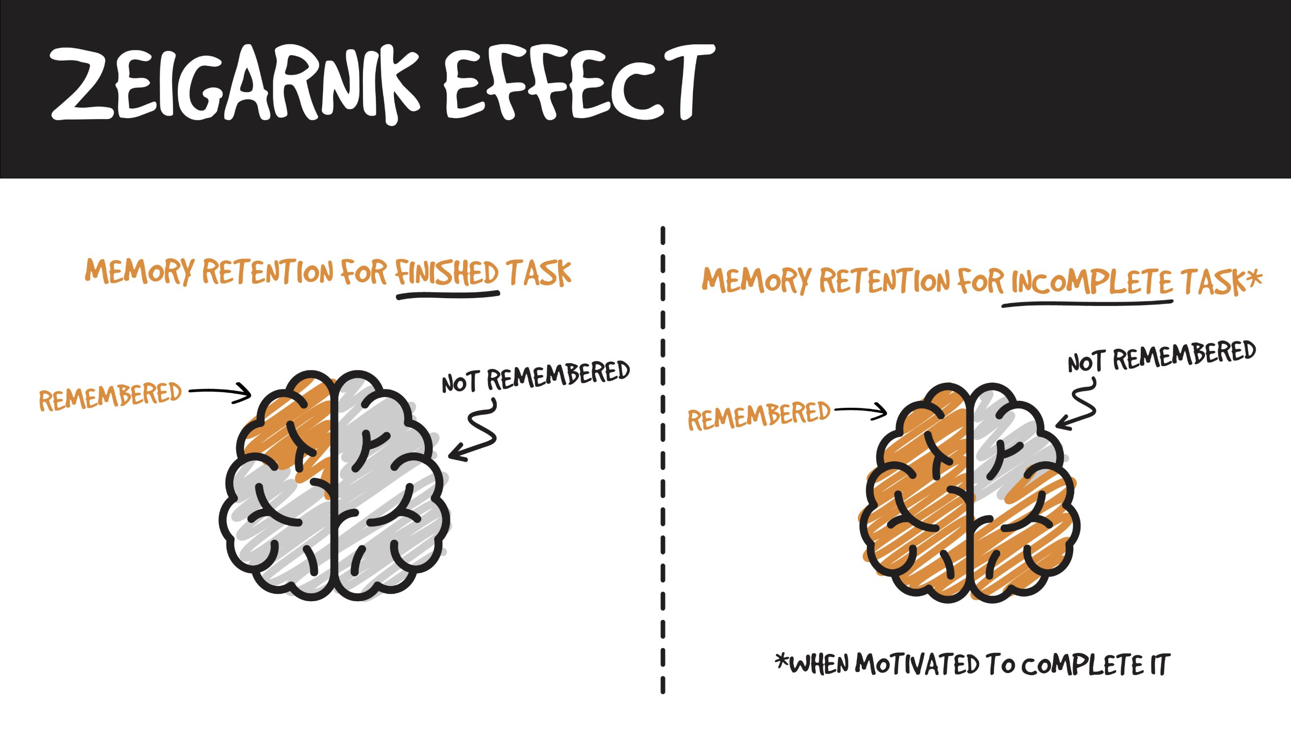

SHORT-TERM MEMORY LIMITATIONS
1. HIPPOCAMPUS
Short-term memory center
Behind your ears
Looks like a seahorse
Has limited capacity
Requires sleep for transfer to long-term retention in cortex
2. ZEIGARNIK EFFECT
Notes:
OUR BRAINS NEED BREAKS!
Hippocampus (short term memory center) has limited capacity! As such, breaks can be useful for taking notes, assimilating thoughts, organizing and chunking information, so that leaners can free up space to take in more info.
During a learning episode, we remember best that which comes first, second best that which comes last, and least that which comes just past the middle. Gazzanniga et al., 2002;
Named after Soviet psychologist Bluma Zeigarnik, in psychology the Zeigarnik effect occurs when an activity that has been interrupted may be more readily recalled. It postulates that people remember unfinished or interrupted tasks better than completed tasks. http://blog.trainerswarehouse.com/powerful-beginnings-and-endings
Leaving and returning to learning (breaks), creates more:
“Firsts” and “lasts, which are more memorable than “middles”
Opportunities for recall and repetition (both of which aid memory as they require the brain to retrieve and re-encode ideas learned before) – remember the memory cycle

Slide 8
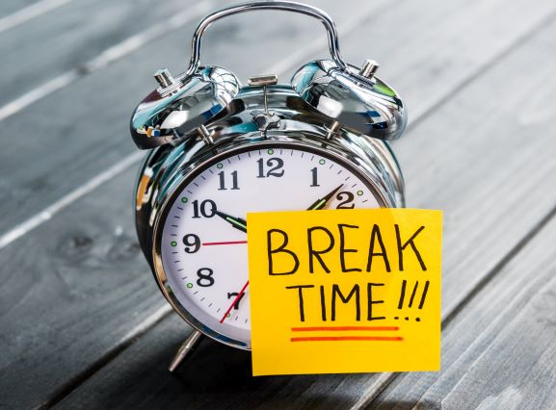
LEARNUS INTERRUPTUS
BREAK
Change or Shift
Shift gears
Take 5
Get physical
Change environments
or BRAKE
Stop or Pause
Hit the Brakes!
Slow down
Take 5
Regroup
Take a note
Notes:
What kind of break?

Slide 9
“B.E.B.E.” 4 BREAK TYPES
 | WHY? | WHAT? | WHEN?
BIO | For personal necessities! | Leave the room. Change scenery. Talk w colleagues. | 15 MINS Every 90 mins. or so.
ERGO | Physical movement to get the blood moving | Stay in the room. Move the body. | 2-3 MINS Every 20 mins. or so
BRAIN | To process and remember information | Stay in the room. Sit or Stand. | 2-3 MINS Every 20 mins. or 8 mins. online
EYEBALL | To give the eyes a rest from screens | Stay in the room. Move the body. | As needed! (especially after lunch)
From Nora Gerber

Slide 10
TAKE FIVE (or more!)
 | OVERVIEW | TRAINER/LEARNER BENEFITS | TOOLS TO MAKE IT FUN
BIO 15 MINS | Leave the room. (outside, weather permitting). Change scenery. Converse w colleagues. | Self-care / comfort / Hydration Mental re- group / email & phone checks Prep for what’s next Ask/Answer questions Socialize Clear-the-slate (hippocampus) to focus Union rules | Break Music Timer Thumballs Games / Puzzles
BRAIN 2-3 MINS | Stay in the room. Sit or Stand. | Improve memory Give time to “encode” Processing content information Take notes, organize, prioritize Reflect, share, discuss, ask Shift mindset Avoid cognitive overload | Sticky Note pads Notebooks Thumball Reinforcement game Breathing exercise
ERGO Ergonomic movement | Stay in the room. Move the body. | Continued focus on content. Improve focus. Manage physical health / avoid stiffness Circulate blood & oxygen Link movement to learning content or learning activities. Rest eyeballs (online) | Dance. Walk. Stretch. Team huddle. Gallery Walk Walk & talk OR Pair & share. Ball Toss. Airplane or Snowball 10-step seek & speak
From Nora Gerber

Slide 11
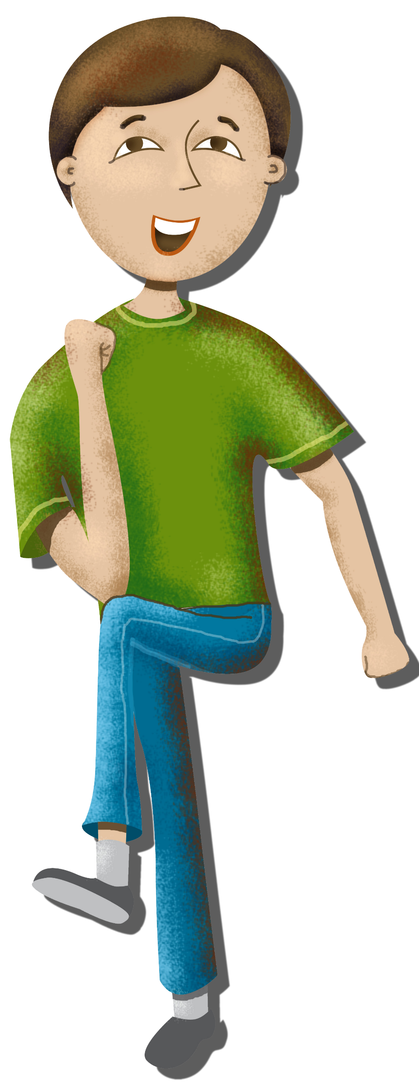
MIDLINE CROSSING
ACTIVITIES
Creates more neural pathways
Strengthen the bridge between the right and left hemispheres
Improve cognitive function
Make you hungry
Increase memory, attention & creativity
Notes:
Which one is NOT a reason to do a midline crossing or cross-lateral movement?
During reading the left hemi does the decoding; the right hemi does the comprehension. X-lateral movmenents prime the brain hemis to work together
This increased communication has been linked to improvements in a wide range of cognitive functions, including memory, attention, and creativity.

Slide 12

TAKE FREQUENT
“P” BREAKS
  Ponder
  Pair
  Participation
  Name as many as you can:
  Breaks that begin with the letter “P”
  Poll
  Position changes
  Physical
  Pranayama
  Play
  Puzzler
  Pun
  Punchline
Notes:
Chat Storm / or Waterfall.
A break that begins with the letter “P”
The breaks in Every 20 minutes attempt to keep these basic principles in mind.
Each brief break offers an assortment of full body motion, off-topic (not off color) jokes and exercises, music and amusement.
Cross body, engage brain in a different way

Slide 13
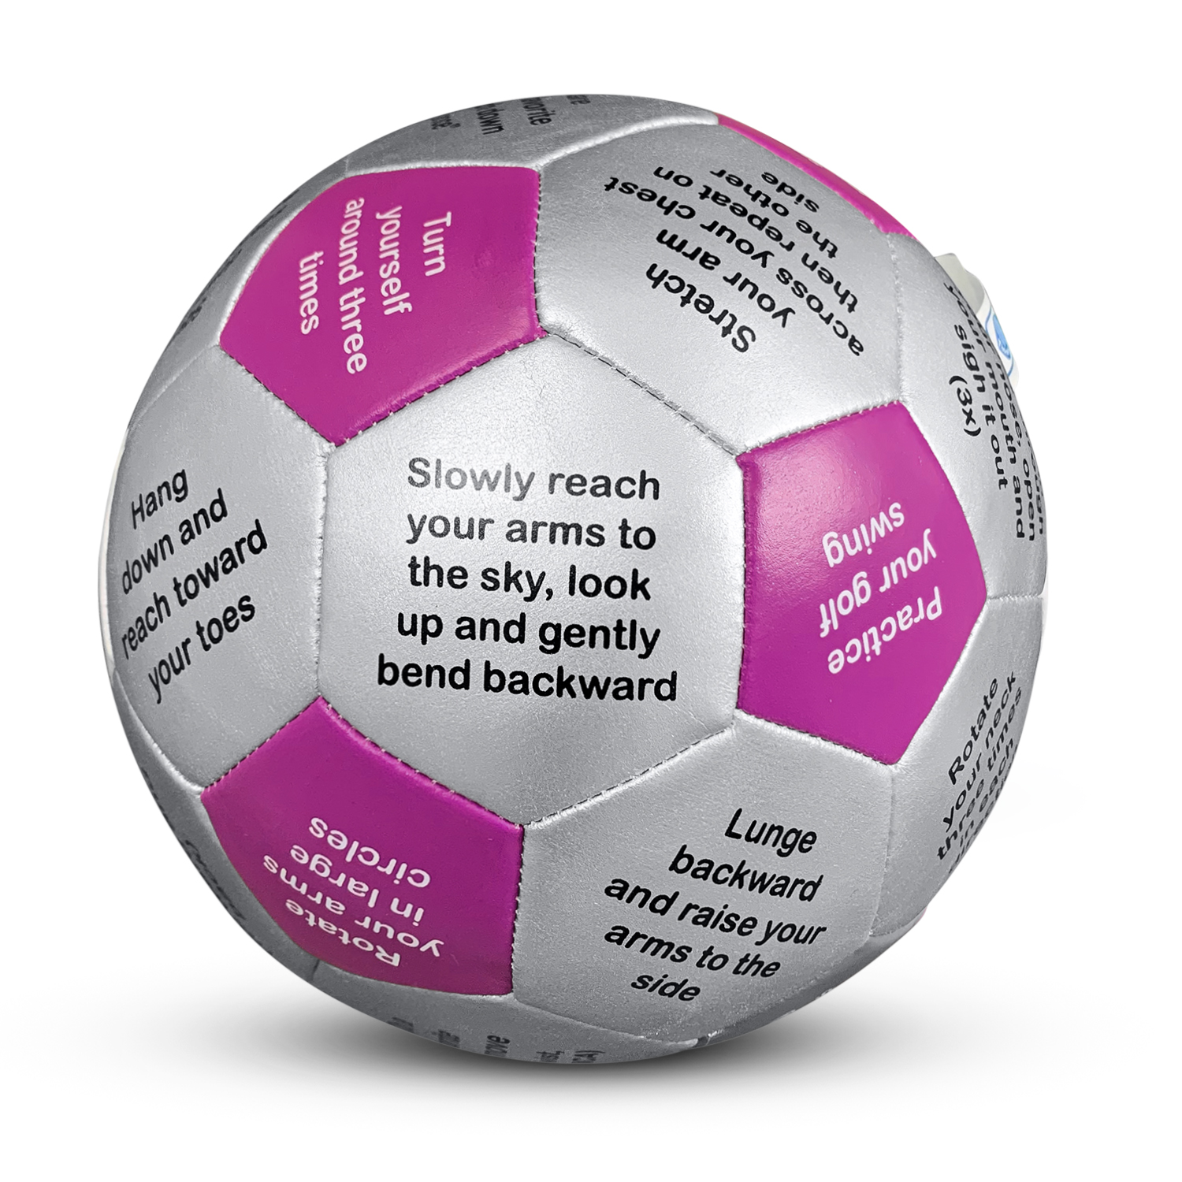
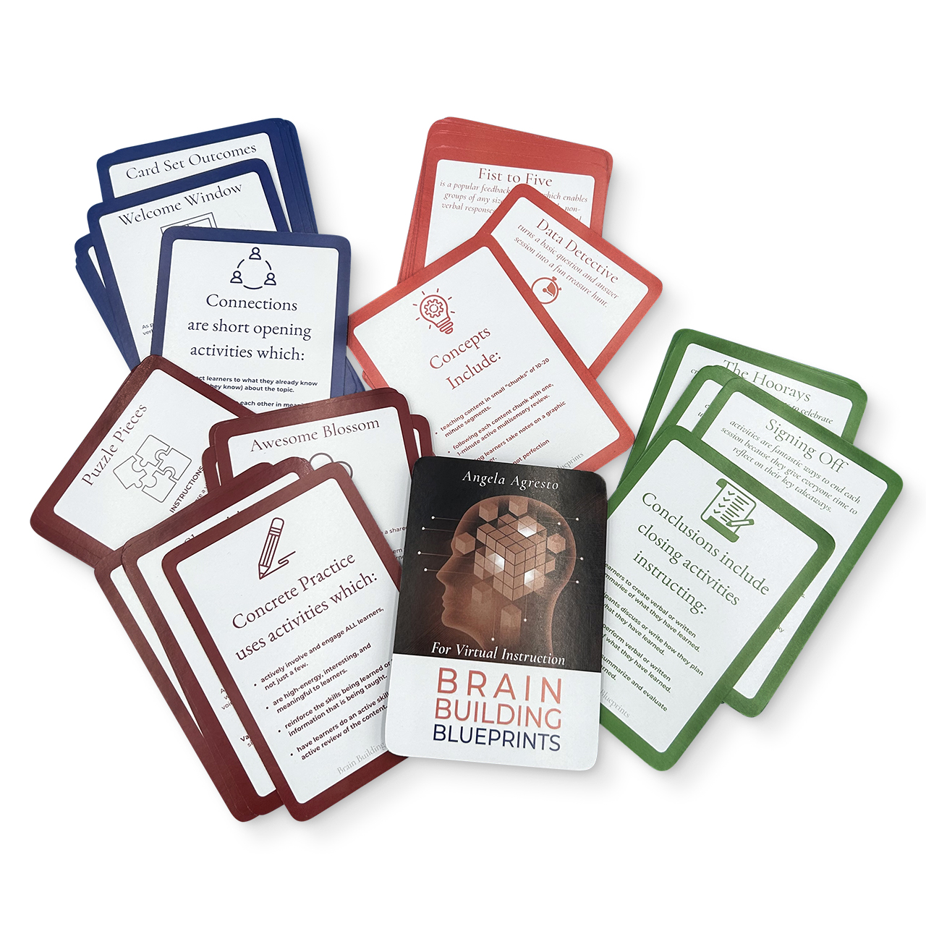
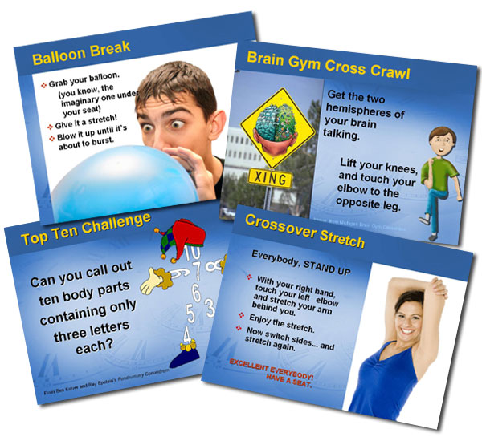
RESOURCES
READY-TO-USE BREAKS
Every 20 minutes: https://trainerswarehouse.com/every-20-minutes-presentation-break-software/
Get Movin’ Thumball: https://trainerswarehouse.com/get-movin-thumball/
Notes:
You can always create your own, but here are some ready-to-use resources.

Slide 14
FROM THE COMMUNITY
TRAINER-TO-TRAINER
Do “The Wave”
Play music from different decades and see who know what songs
Use a breaks to break up “hot spots” in the room
If the training requires a step-by-step process, have the each draw a “step” on a sheet of paper and then line up sequentially.
Use the “EEN” Break model
ON-TIME RETURN STRATEGIES
  Give an odd time for the group to return (i.e. 1:13)
  Promise “bonus content” to those who return on time!
* Use the latrine * Get some caffeine * Check your answering machine * Read a magazine *

Slide 15

Every 20 Minutes
MORE BREAK IDEAS
Air Guitar
Bad Joke
Balloon Visualization
Bathroom Song
Brain Gym Cross Crawl
Brain Teaser
Clap Pass
Crossover Stretch
Exercisin’ Song
Hand Jive
Hand Foot Coordination
Hidden Meaning
Mini Mystery
Number Challenge
Paper Airplane
Power Nap
Resumé Laugh Lines
Skywriting Break
Tag Team Ball Toss
Tongue Twister
Top Ten Challenge
Two Minute Vacation
Notes:
The breaks in Every 20 minutes attempt to keep these basic principles in mind.
Each brief break offers an assortment of full body motion, off-topic (not off color) jokes and exercises, music and amusement.
Cross body, engage brain in a different way

Slide 16
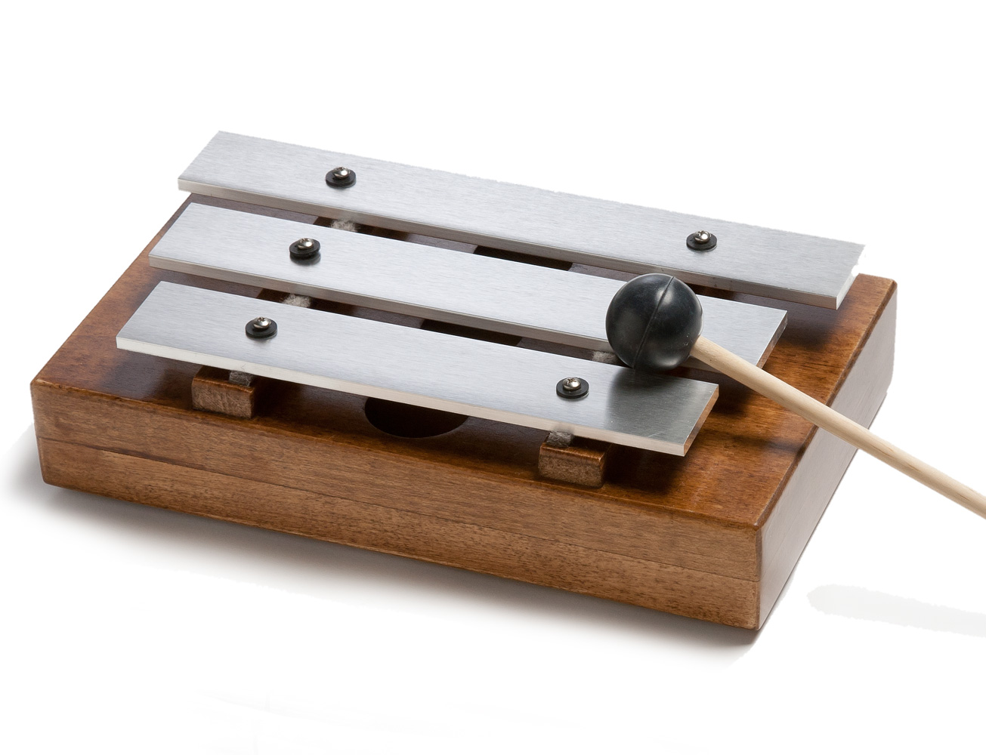
GETTING BACK
POST BREAK TIPS
Play the same song every time
Coordinate watches
Always start on time
Repercussions for late arrival
Reward for on-time entrance
Notes:
Which of these strategies can you imagine adding to your repertoire? Why?

Slide 17
GIVE ‘EM
A BREAK by Trainers Warehouse www.trainerswarehouse.com

